Slide 1
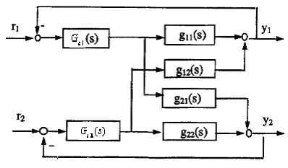
Design by Detuning Factor
Effects of interaction on tuning by RGA, reflected by detuning correlation
Procedure:
Use any single-loop tuning rules to obtain starting values for individual controllers; let controller gains be K_{ci}.
These gains should be reduced depend on relative gain parameter λ
It may still be necessary to “retune” these controllers after they have been put in operation. much less effort than starting from scratch.

Slide 2
Principle on Design Decentralized Controller
Original
EFT based on RNGA
Integrity: controller is no more aggressive than SISO without interaction
Select maximum
Why?
Select maximum
Why?
Phase cross over frequency

Slide 3
ETF Summary
Parameter change
ETFs

Slide 4
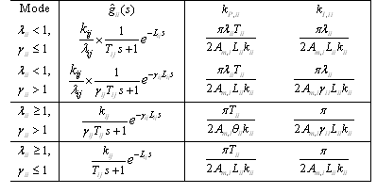
ETF Summary
Parameter change

